Slide 1

Facilitation of Cryptocurrency Price Prediction by Sentiment Analysis
Sai Yeshwanth - A20514173 Ashlesh Khajbage - A20517913 Chandana Poloju - A20527866 Swastika Pandit - A20503284 Sai Deepthi Pinninti - A20513400

Slide 2
Overview
As we know Cryptocurrency is a dynamic and rapidly changing market, making it difficult for investors to make informed decisions.
Sentiment analysis has emerged as a promising tool for analyzing the emotional tone behind news articles, social media posts, and other online content related to cryptocurrency.
In this project, we aim to explore the use of sentiment analysis to facilitate cryptocurrency trading decisions.
To achieve this goal, we scraped data from various news articles and collected price data for several cryptocurrencies during a specific time period. Using exploratory data analysis, we identified which cryptocurrencies to focus on and selected a few for further analysis.
We implemented a machine learning model to predict price changes based on sentiment extracted from the text of news articles.
Additionally, we conducted a time series analysis to further understand the relationship between news sentiment and cryptocurrency price movements.

Slide 3

What we seek to address
Does historical data of BTC, ETH, status, or ratings influence this result?
How were cryptocurrencies trending during that period?
What were the top 10 cryptocurrencies and their market capitalization at that time?
Do the total traded Quantity and Close Price of the coin hold any sort of relation between them?
Which analysis model will be best for the analysis of the dataset?
Can we analyze price movements and trading volumes and give 7-day predictions?

Slide 4
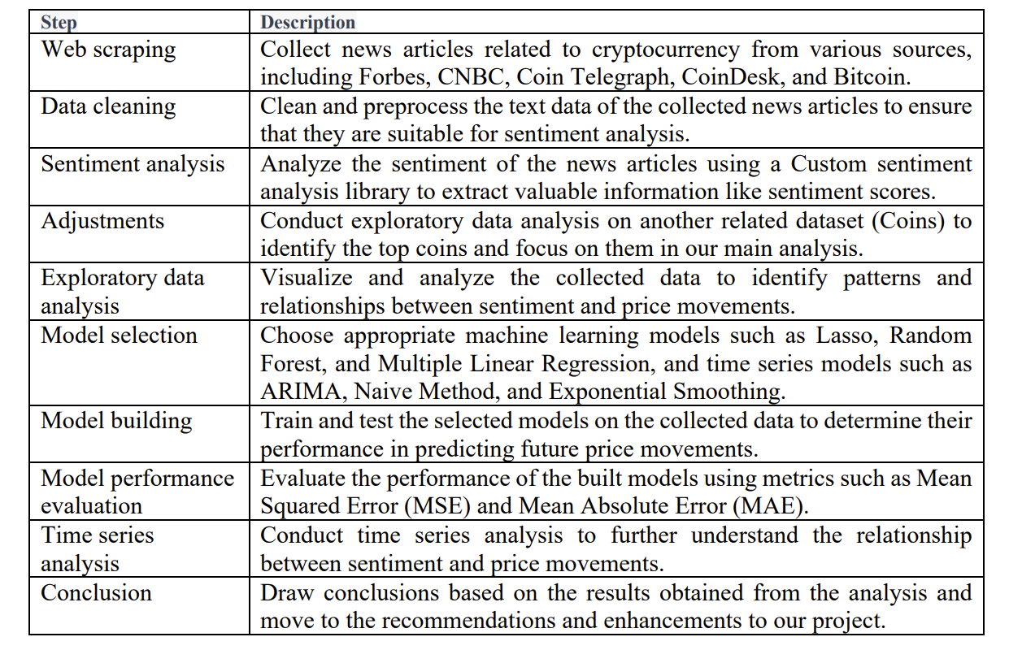
Project Methodology

Slide 5

Data Acquisition
We utilized two primary categories of data.
The first type consisted of Investing.com's historical price data for 10 cryptocurrencies, which included Binance Coin, Bitcoin, Cardano, Dogecoin, Ethereum, Polkadot, Solana, Tether, USD Coin, and XRP.
The CSV data columns included Name, symbol, date, price, open, high, low, volume, marketcap and percentage of daily change.
The second type of data utilized in this project was 360 news articles from five different crypto news sites, including Bitcoin, CNBC, Coindesk, Cointelegraph, and Forbes.
These articles were scraped between May 16, 2017, and June 2018, for analysis of the sentiment of the news coverage on 10 selected cryptocurrencies.

Slide 6
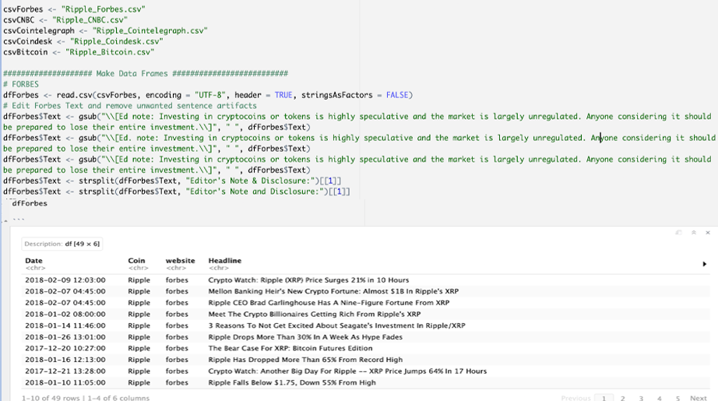
Text Data Processing
Data Cleaning
Firstly, we segregated the data from CSV into data frames and encoding this to “UTF-8”
removed noises, such as HTML tags, special characters and texts which are unnecessary for the sentiment analysis.

Slide 7
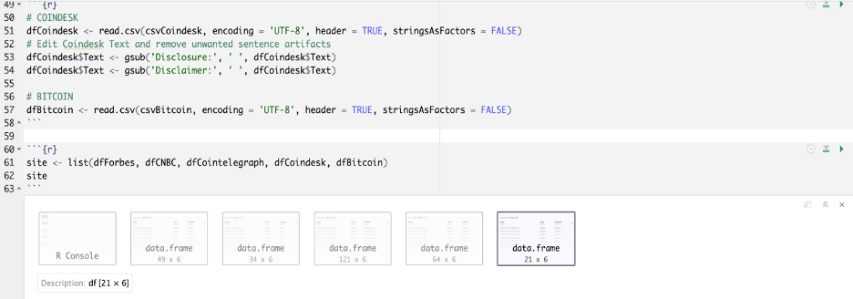
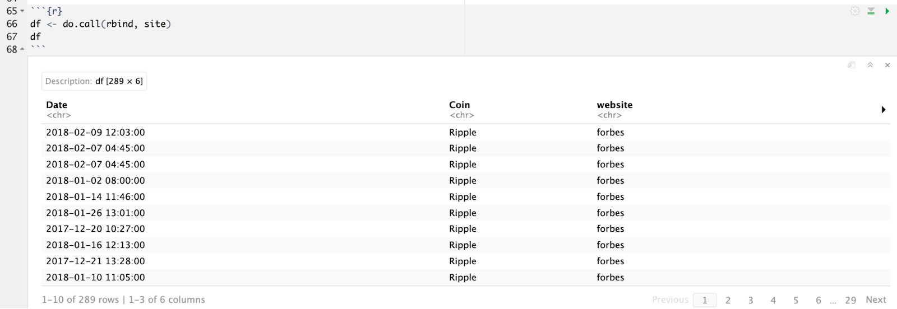
Text Data Processing
We did similar for all five data frames (Forbes, CNBC, Cointelegraph, Coindesk and Bitcoin)
Data Joining
We then bound all the data frames into one data frame for sentiment analysis

Slide 8
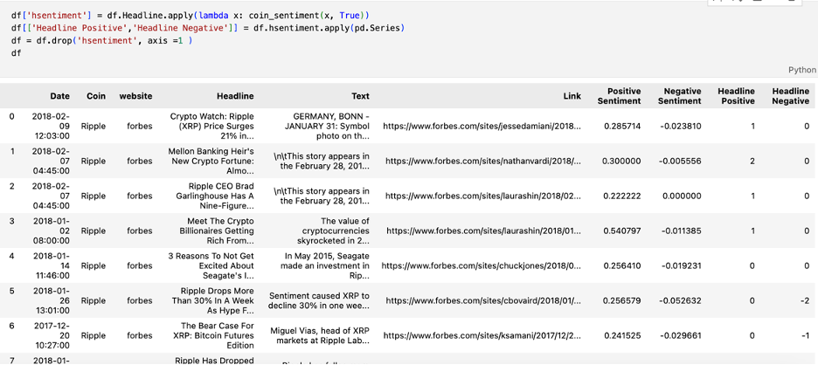
Sentiment Analysis
To perform sentiment analysis we used Python code to compute sentiment scores based on positive and negative word libraries

Slide 9
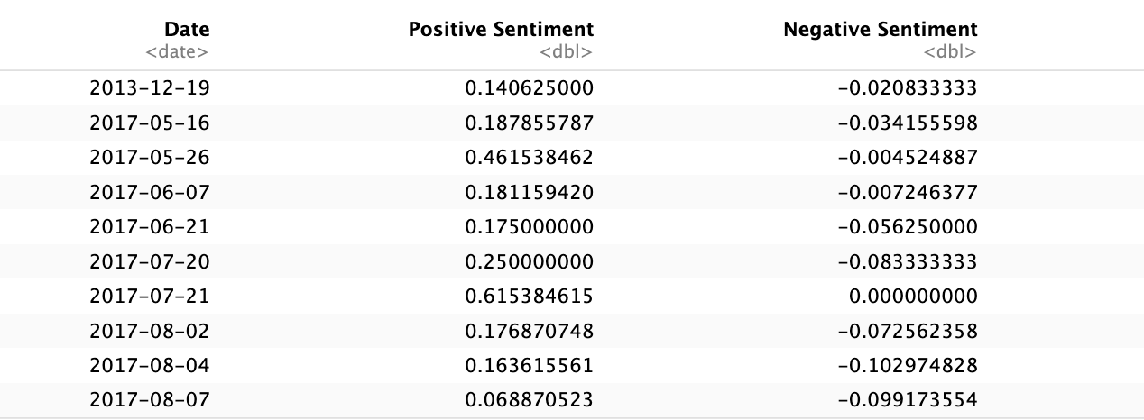
Sentiment Aggregation
To determine their level of positivity or negativity we conducted sentiment analysis on both - headlines and text.
Initially, only the sentiment of the text was taken into account, while the sentiment of the headlines was reserved separately in case it could be utilized later for more informed evaluations.

Slide 10
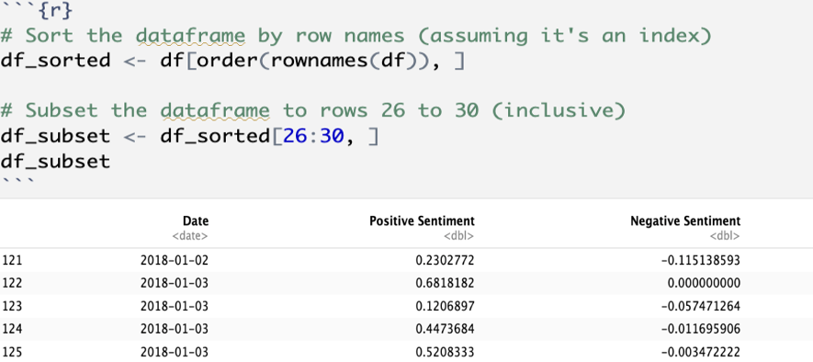
Issues Encountered
How to assign a ranking to dates that had multiple sentiment scores
The presence of multiple scores for a single date indicated that multiple articles were generated and analyzed on that day.
For example, on January 3rd, there were four distinct articles written.

Slide 11
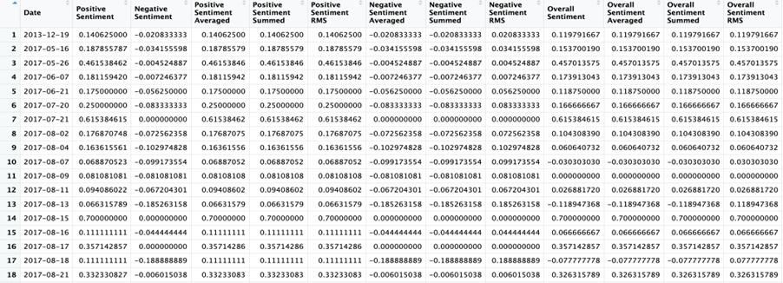
Solution
Firstly, we created aggregates of sentiment averaged, sentiment root mean square (RMS), and sentiment summed were calculated to later analyze the best metric.
Secondly, we also calculated “overall" sentiment to reflect the size of both intrinsic ratings.
The "overall sentiment" was calculated using the same procedures as were used to aggregate the various articles.
Each article's Positive and Negative Scores were averaged, RMS-summarized, and added together to provide an "overall sentiment" for that item.

Slide 12
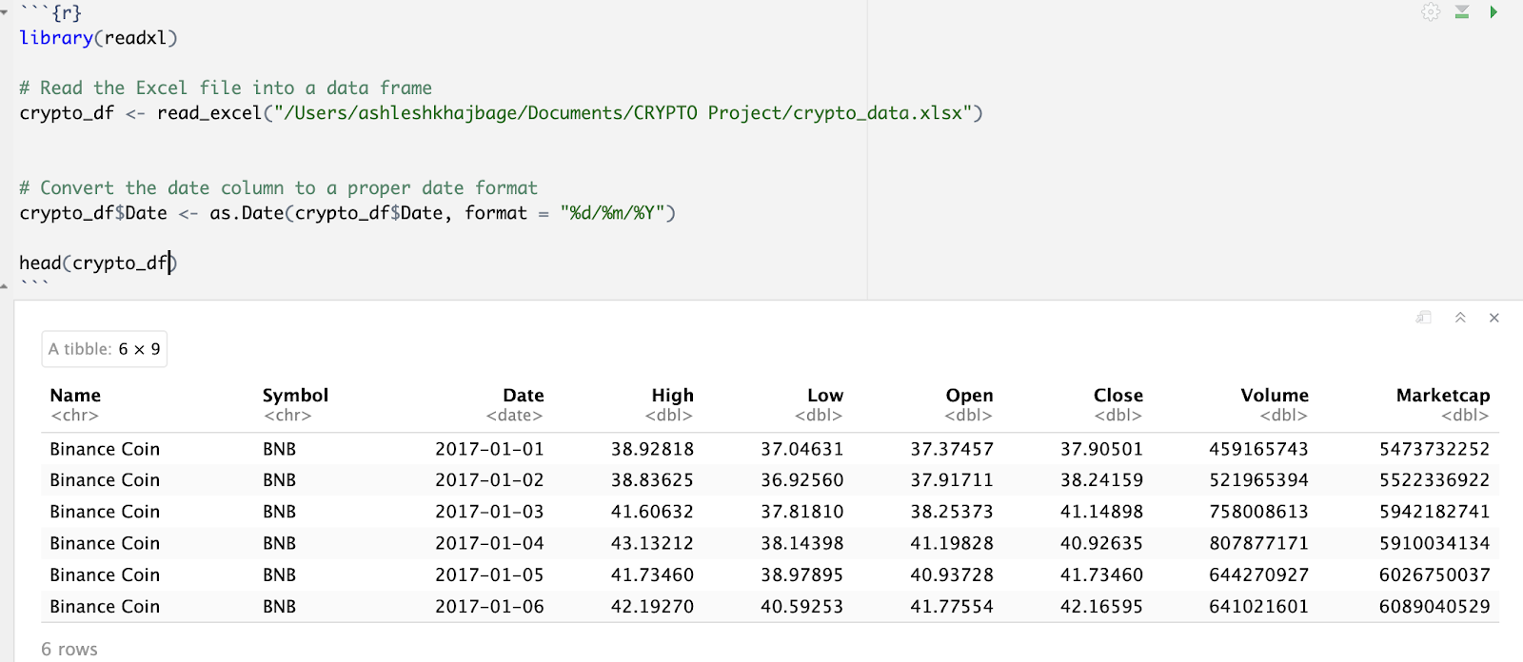
Price Data Processing
We have ten coins and need to know the top three to perform the analysis.
Data was acquired from the Investing.com website in order to conduct a study on the top three coins out of a group of ten.
The data was then subjected to univariate and bivariate analysis to detect coin association with the purpose of identifying the three coins for further research and modeling.
Following this, exploratory data analysis on the main dataset was performed.

Slide 13
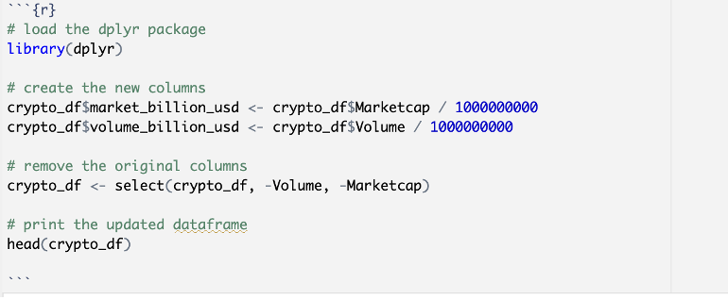
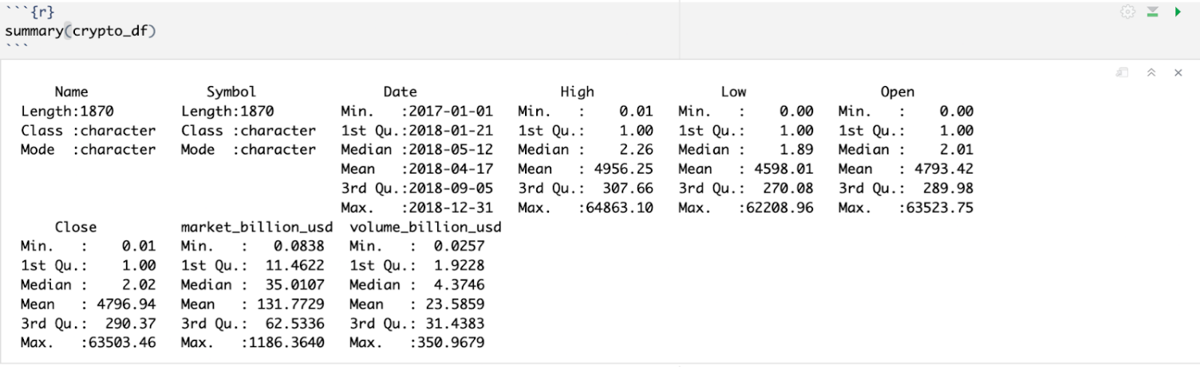
Data Cleaning and Preparation
Removed missing values
Checked for duplicate entries. - No duplicates.
Performed simple data manipulation to convert the market capitalization and volume values to more interpretable units.

Slide 14
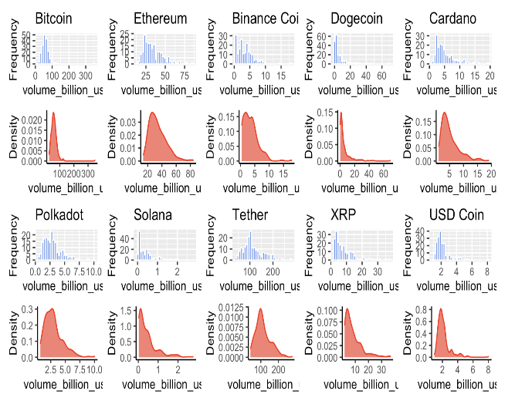
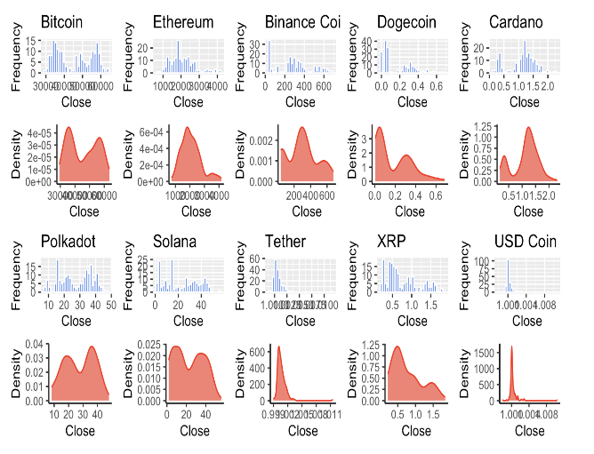
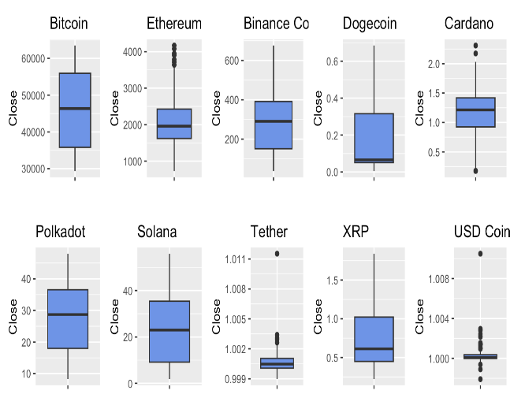
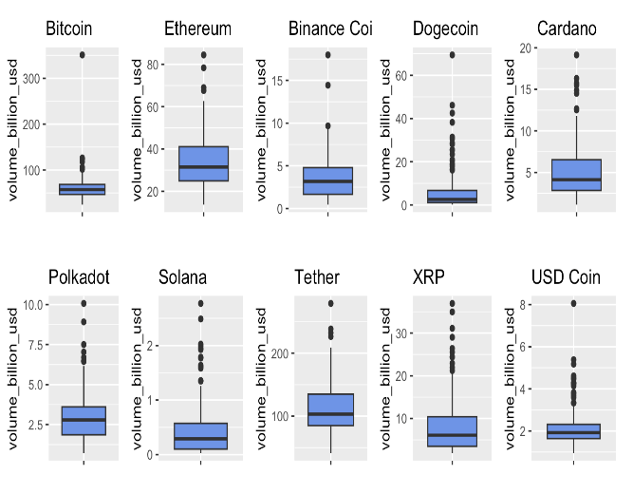
Univariate Analysis
We performed univariate analysis to
examine the distribution and summary
statistics of individual variables.

Slide 15
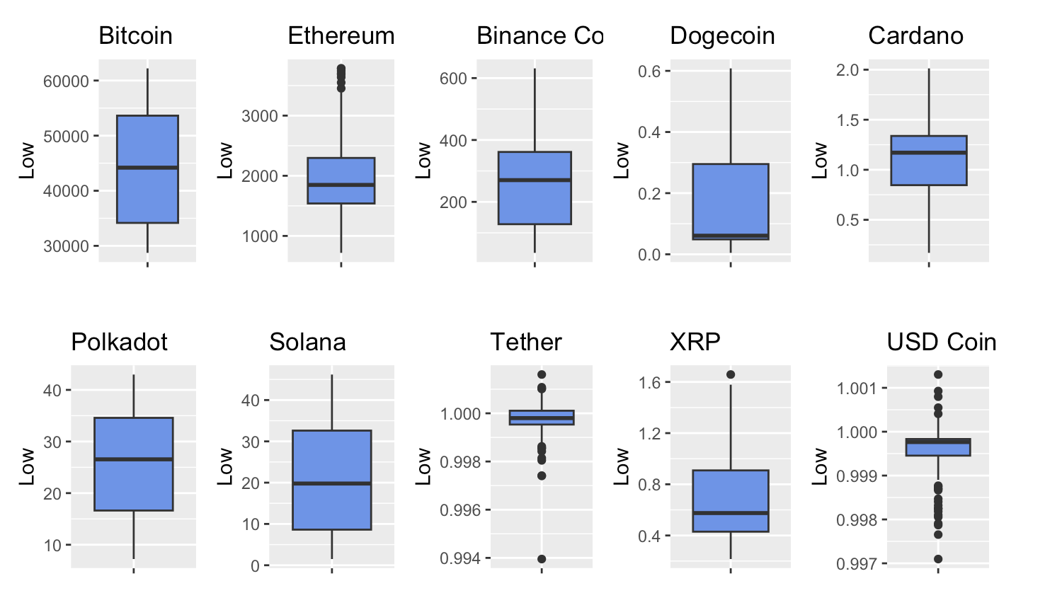
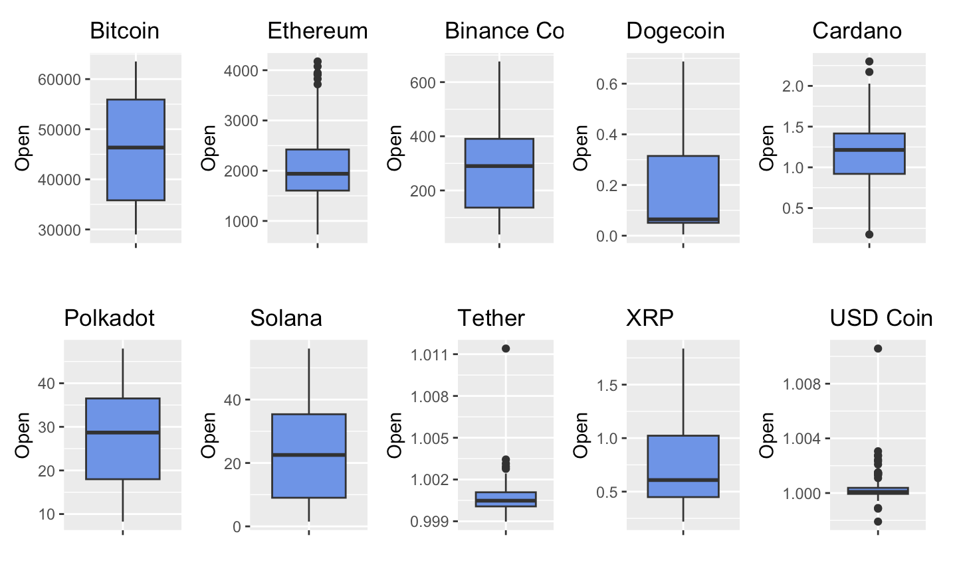
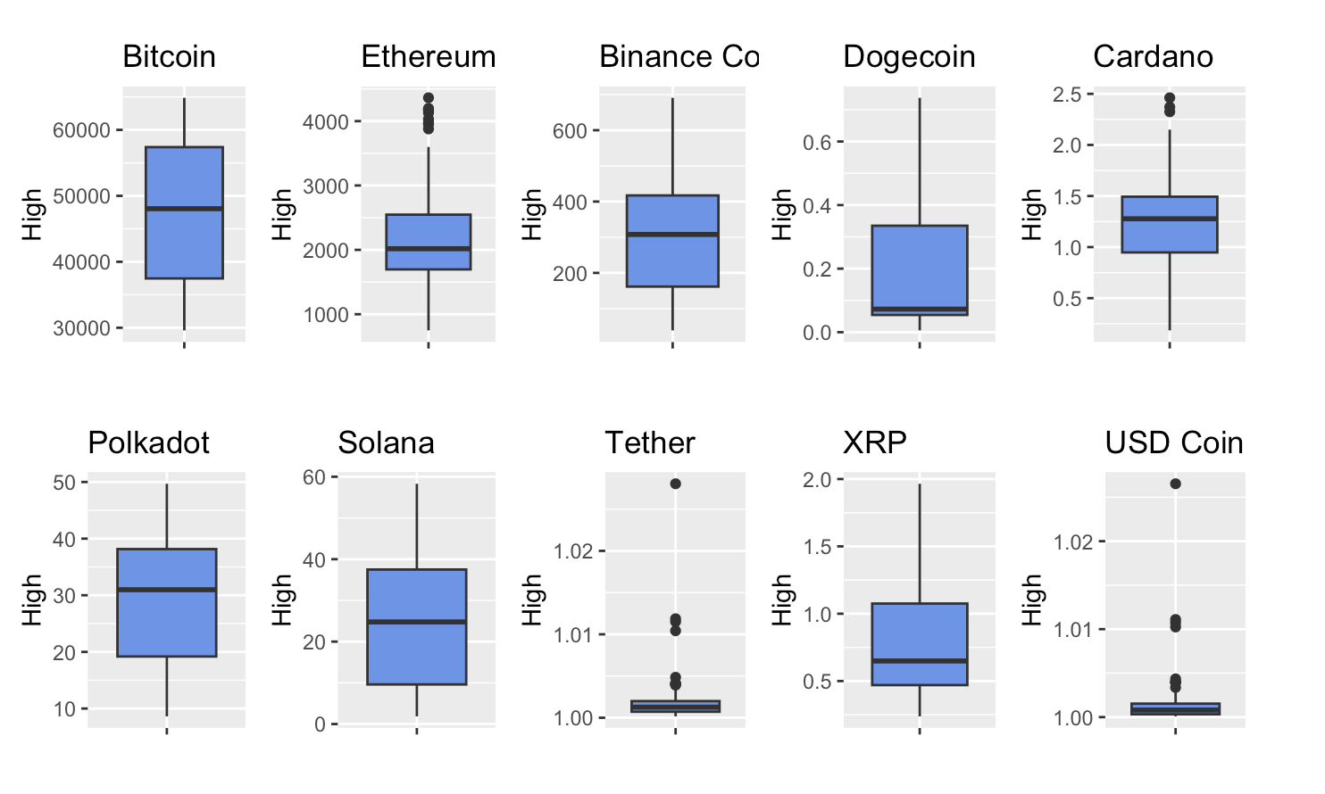
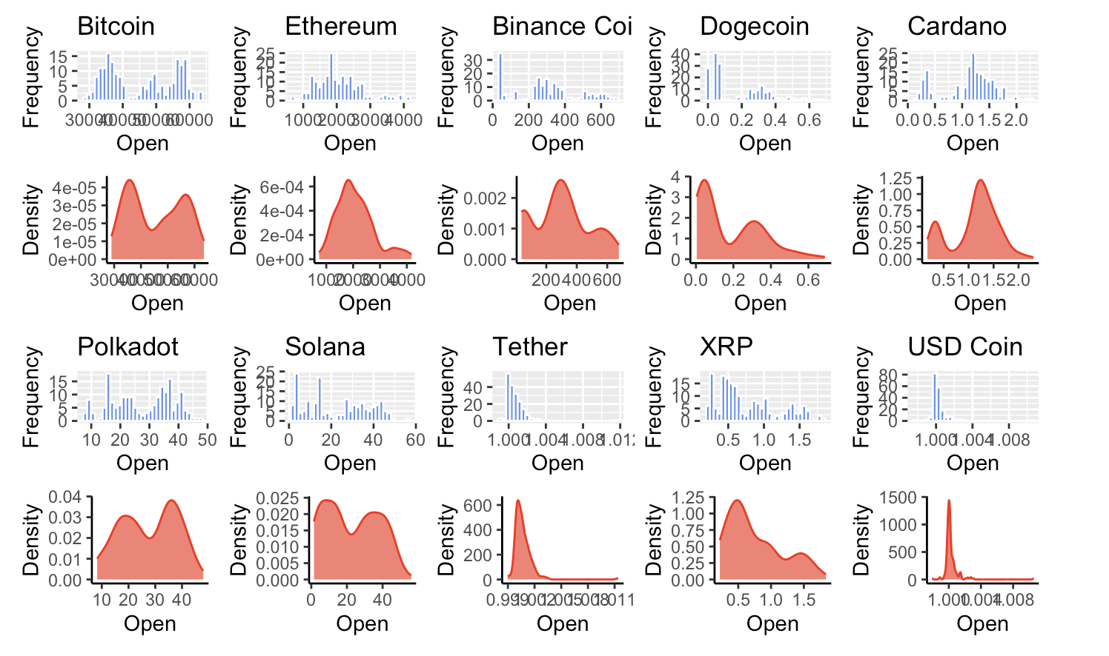
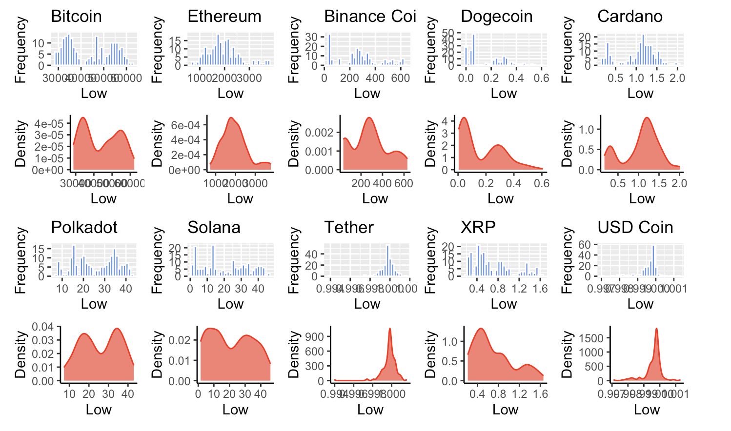
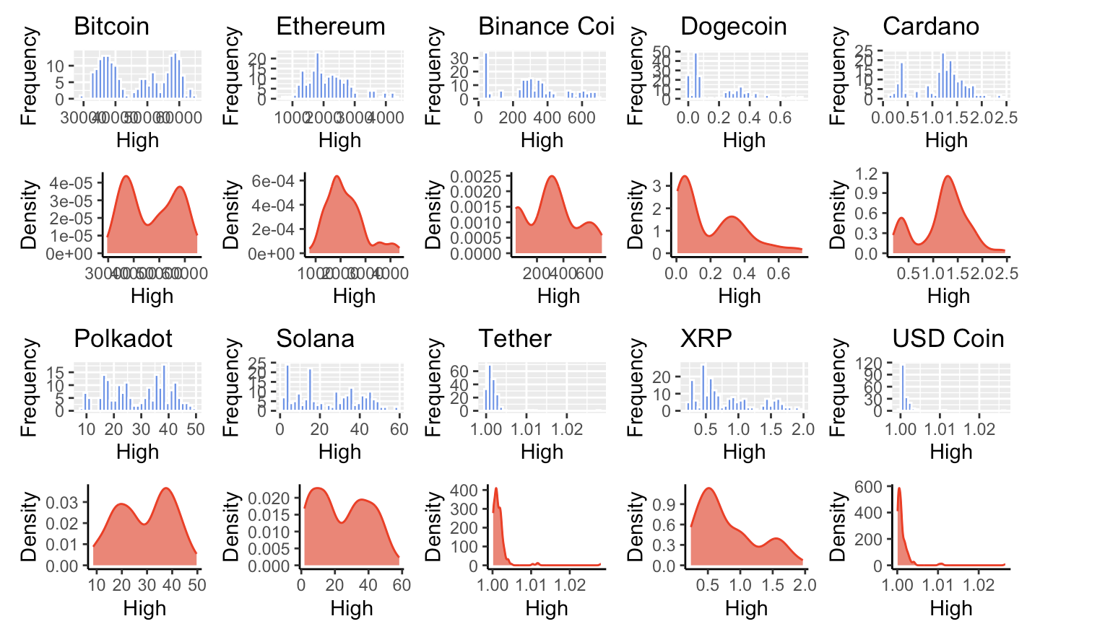
Univariate Analysis

Slide 16
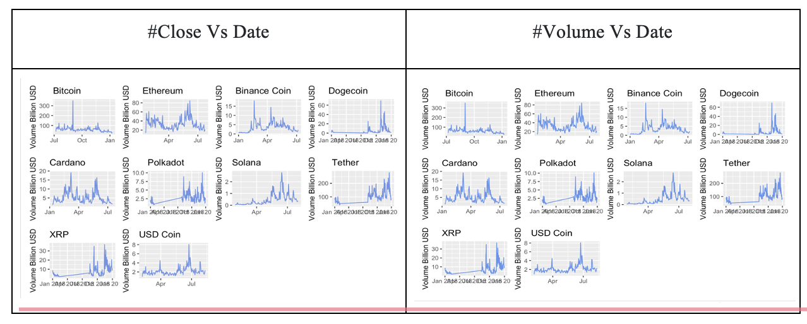
Bivariate Analysis
Inferences:
While high, low, price, volume, and market values can also provide useful information for analyzing financial data, the closing price seems to have a distribution and statistics on which we can work.
Also, close price is typically the most used parameter for calculating daily returns and performing trend analysis.

Slide 17
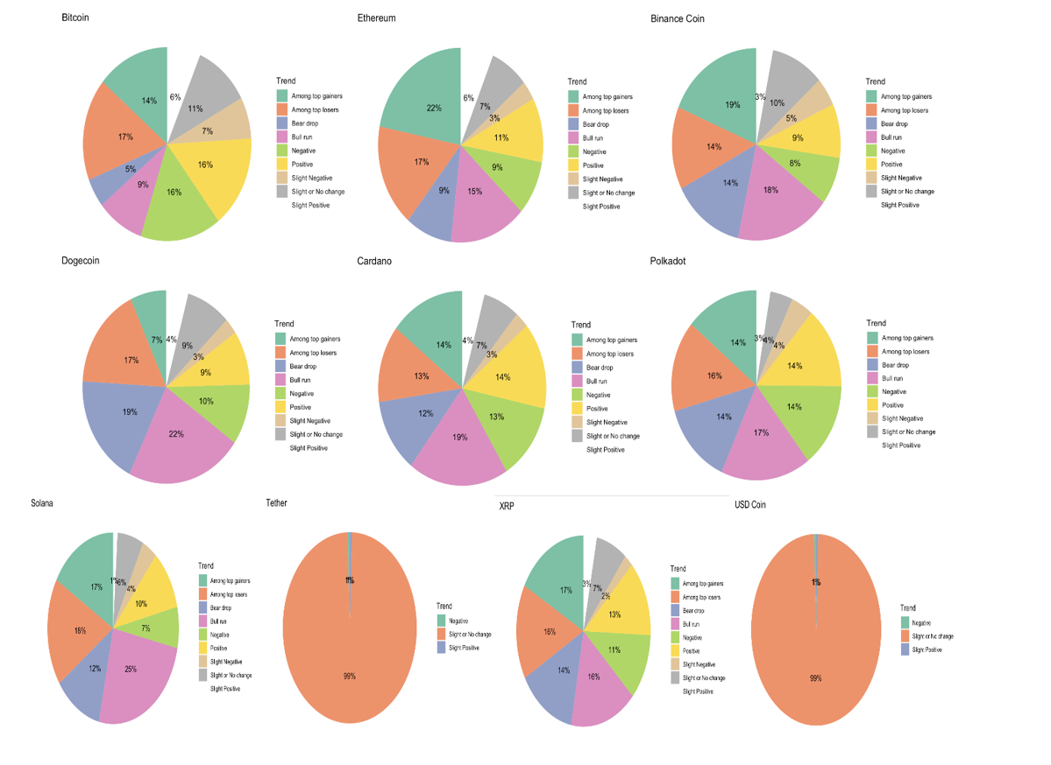
Trend Analysis
For trend Analysis, we added a new column ‘Trend’ whose values are based on the day-to-day percentage change which we calculated from the closed price.
Following were trends determined
Slight or No change
Slight Positive
Slight Negative
Positive
Negative
Among top gainers
Among top losers
Bull run
Bear drop

Slide 18
Trend Analysis
Inferences -
From the trends, we can evidently assume that XRP would follow closely in the trend of either BTC or ETH.
As their trend percentage are closely related. We can further analyze this from correlation and time series analysis.

Slide 19
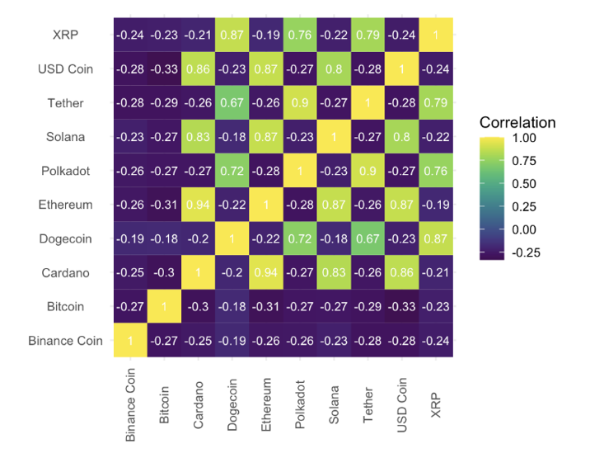
Is there any Correlation among Coins ?
To Answer this, we plotted a correlation plot between cryptocurrency prices, which can help us to better understand the relationships between them.
We found there is a strong positive correlation between the prices of Bitcoin and most other cryptocurrencies.
This suggests that changes in the price of Bitcoin are likely to have a similar effect on the prices of these cryptocurrencies.

Slide 20
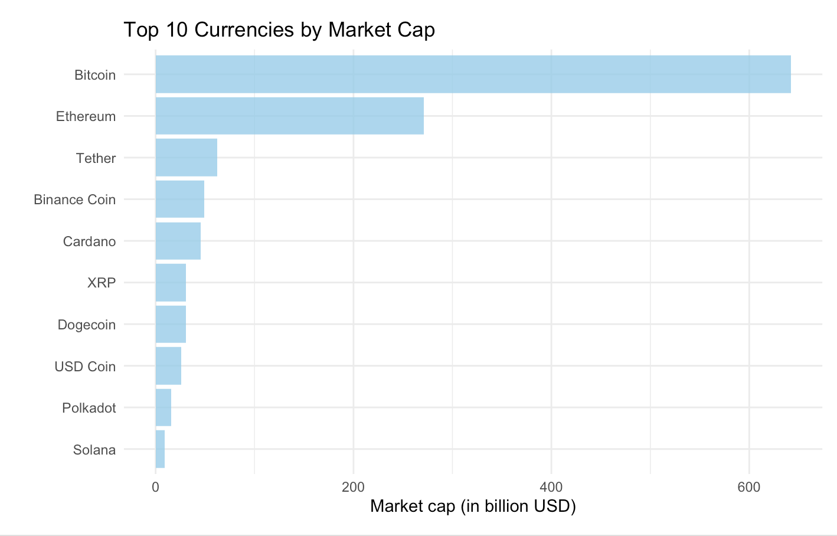
Which of these coins were among Top 10 during that time?
From the plot, we can see that Bitcoin has the largest market capitalization, followed by Ethereum and Tether, Binance Coin, Cardano, XRP.
Dogecoin also has market capitalization of over 30 billion USD, while USD Coin, Polkadot, and Solana have smaller market capitalizations.
Decision:
We need to perform further EDA on specific coins.

Slide 21
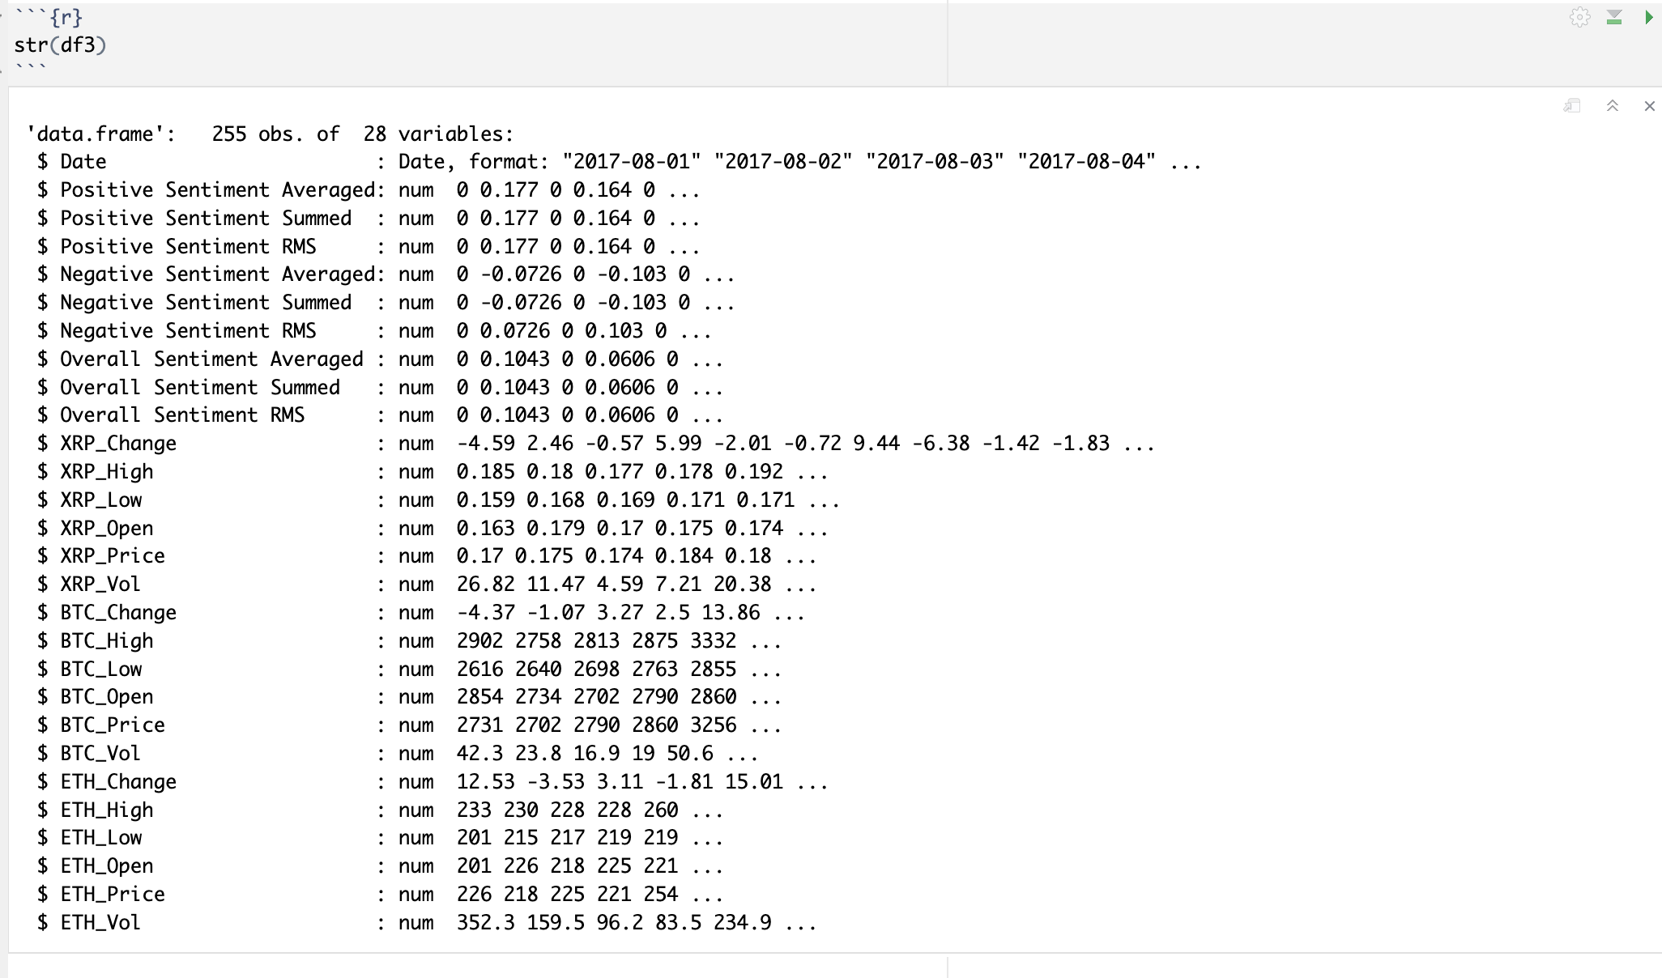
More Exploratory Data Analysis
So we selected XRP, Bitcoin, and Ethereum.
We chose them because to their widespread usage in purchasing other cryptocurrencies and because the market generally follows the trend of Bitcoin.
We subset out these coins’ data and merged it with previously collected Sentiment data.

Slide 22
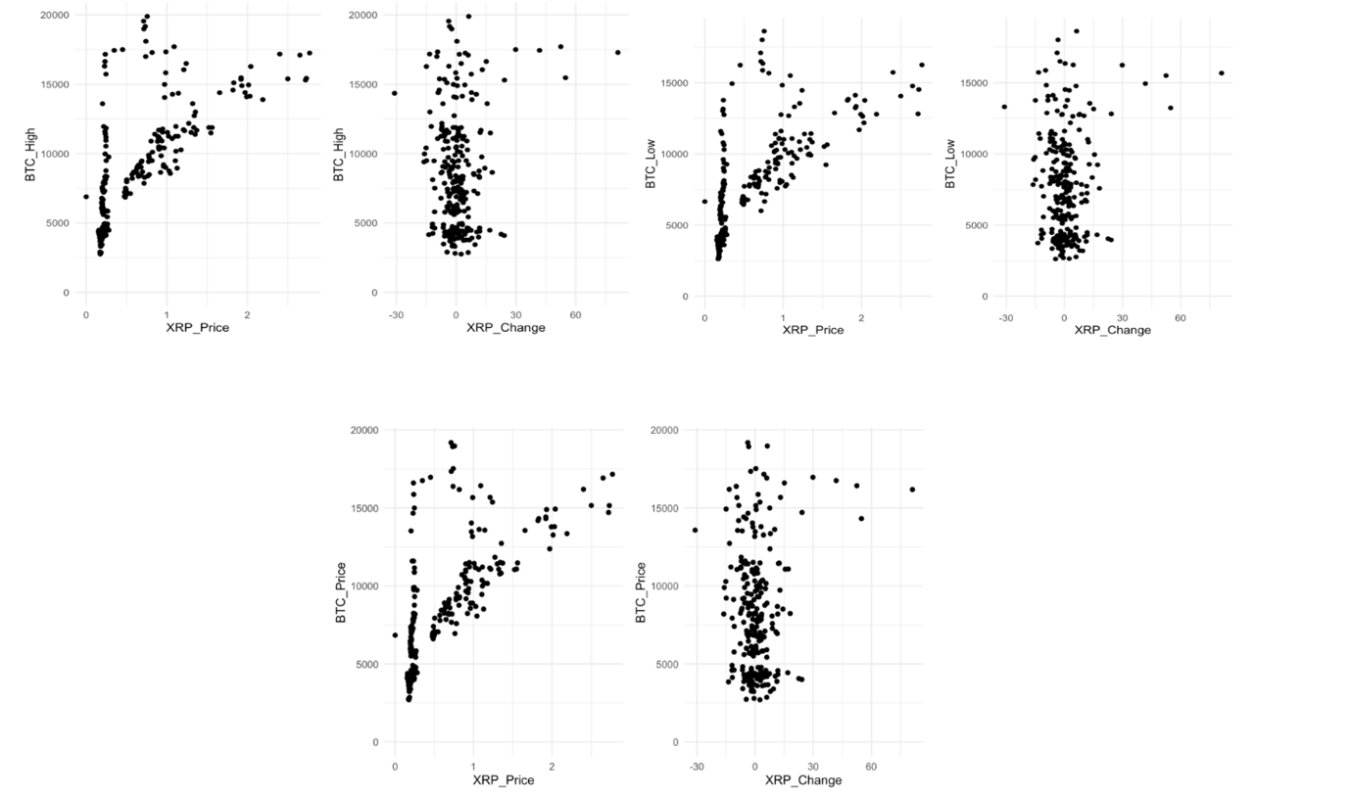
XRP Correlation Analysis
Although the positive link between XRP and BTC was evident from correlation table, we plotted pair-plots to understand more.
The link is evident when plotting Bitcoin prices (High, Low, Close) vs. XRP prices. But it is now transparent why BTC failed to merit a correlation.
Inferences-
There seems to have been a period where the value of BTC rose significantly while XRP stayed largely unchanged. The idea that the market closely tracks BTC goes against this.
Bitcoin-XRP Price correlation pair plots

Slide 23
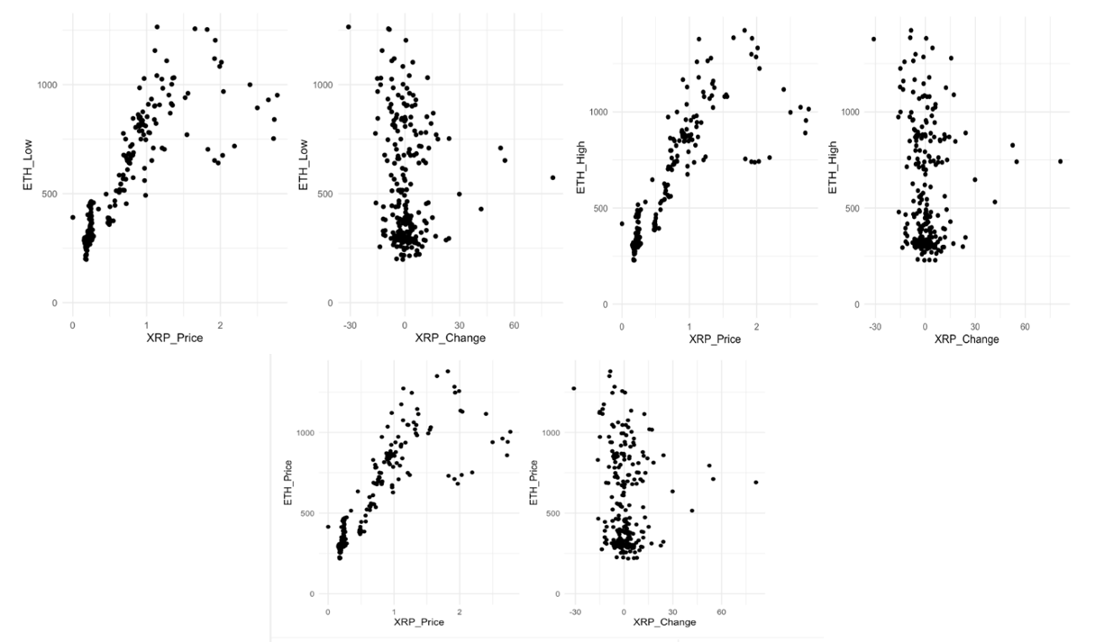
Ethereum vs XRP
Observation:
Here the movements of XRP and ETH were nearly identical in a 1:1 ratio
However, XRP experienced a sudden exponential surge in price only after it had reached a certain point, while ETH continued to follow a linear trend
This observation suggests that ETH is a more reliable indicator of XRP's price, thereby dismissing the idea that BTC is the dominant trend to monitor.

Slide 24
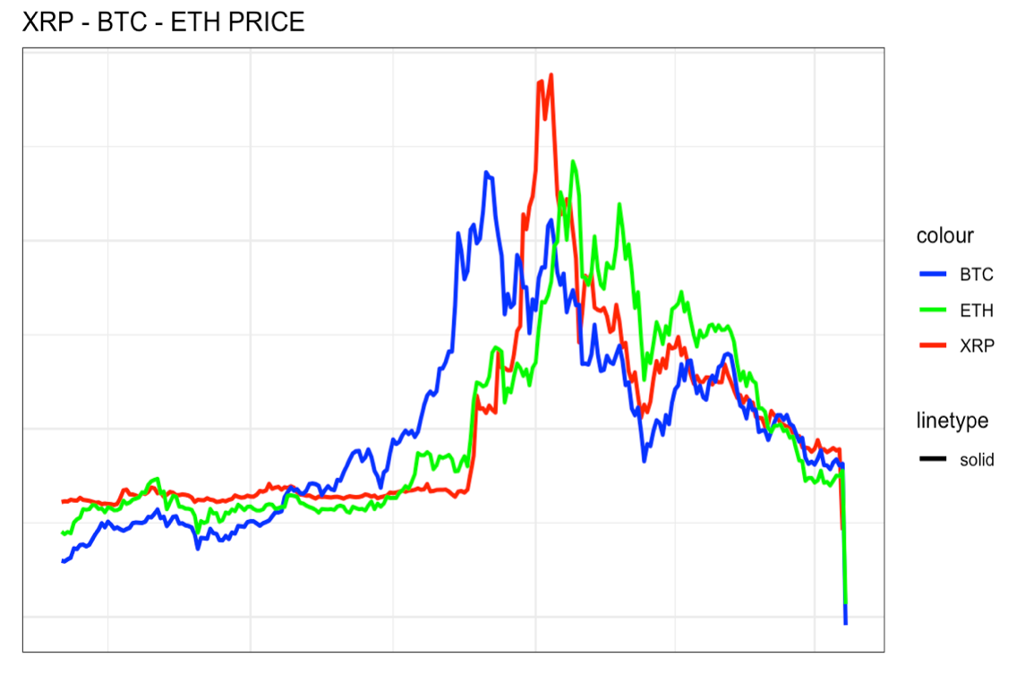
Time Series Analysis
The correlation characteristics of all three-time series were fully revealed when plotted together
Observations:
It appears that XRP tends to follow ETH's price fluctuations with a delay of one or two days.
There is a flat line correlation trend between XRP and BTC in the pair plot.
The price of XRP remained relatively stable while BTC experienced a significant price surge.

Slide 25
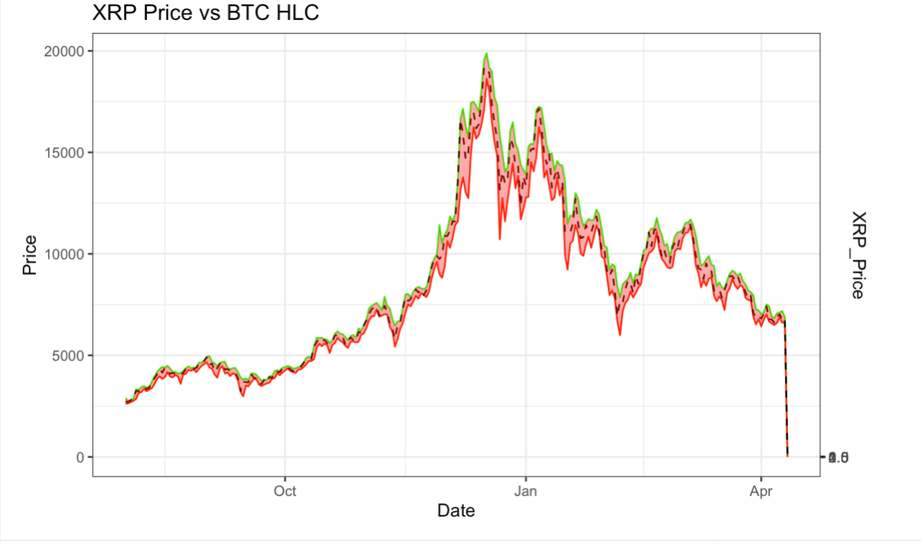
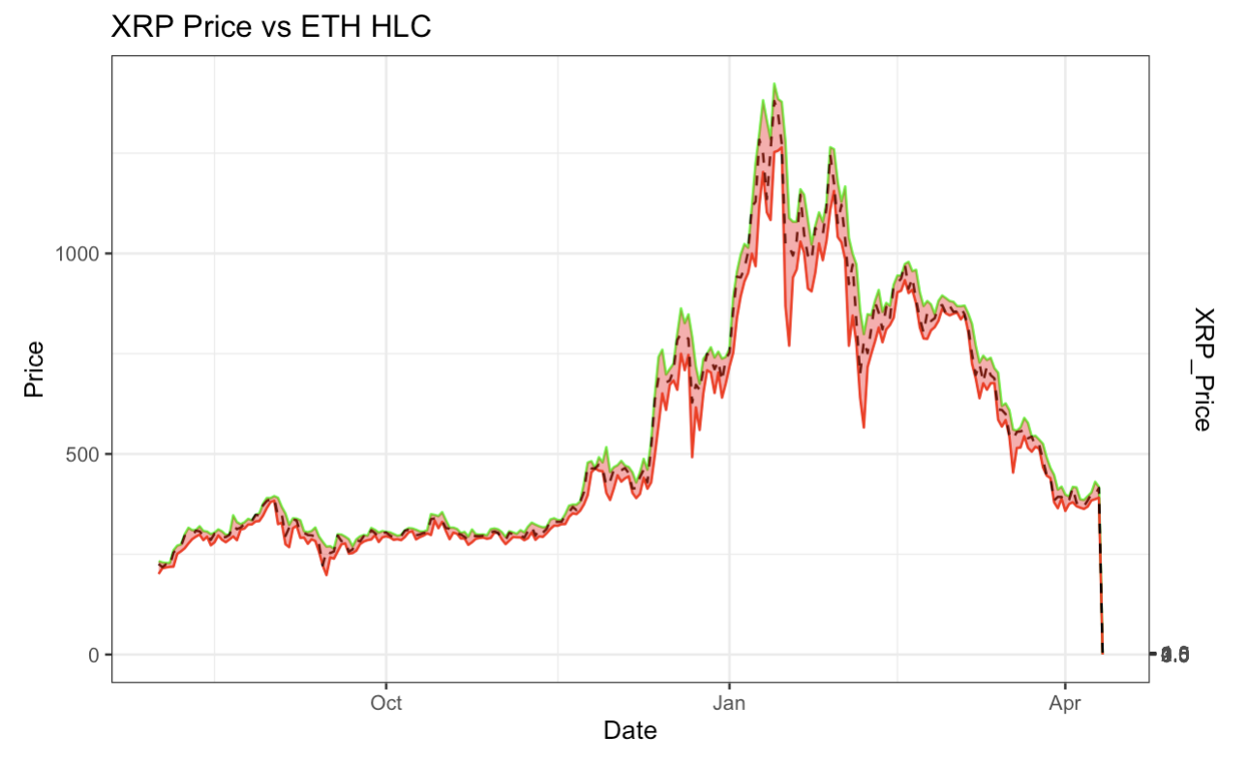
Time Series Analysis
In hopes of revealing further trend characteristics, XRP price was plotted against the full High, Low, Close (HLC) characteristics for BTC and ETH.
Observations:
Despite attempting to break down BTC and ETH into their respective High, Low, and Close (HLC) constituents, no further trend was discovered.
However, it was observed that both ETH and XRP experienced significant price surges after BTC's price peaked and then declined.

Slide 26
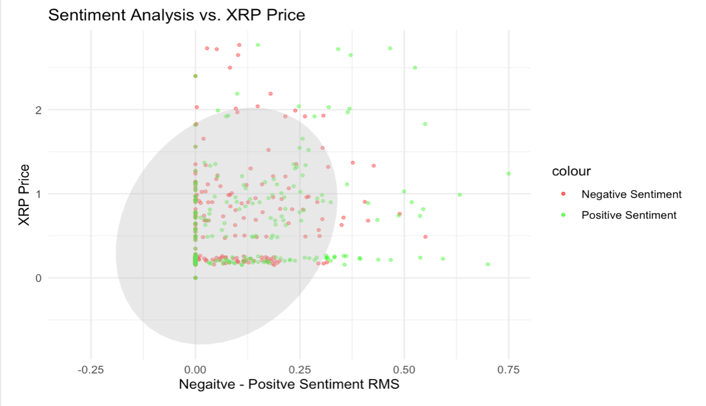
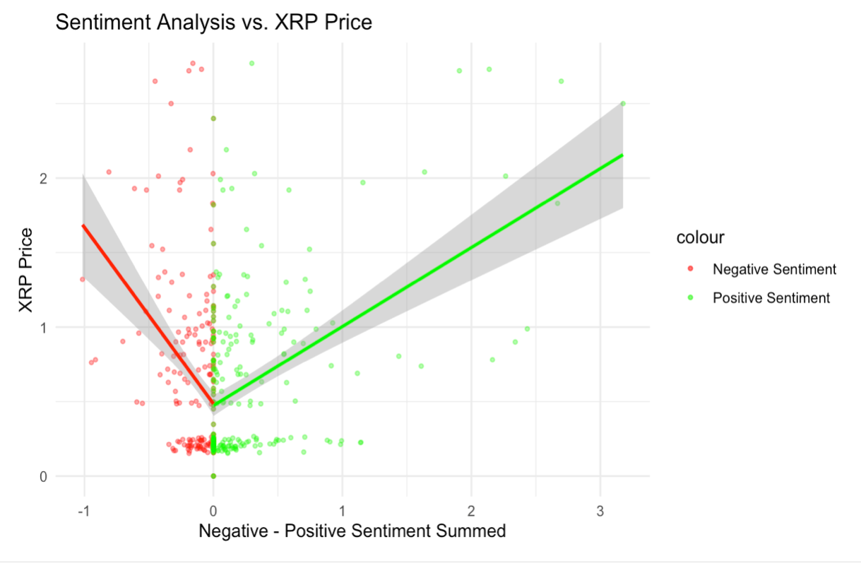
XRP Response to Sentiment
Observation
Summed sentiment appeared to be a better metric, as a sentiment of 3 corresponded to a high XRP price value.
Further analysis was performed by plotting both positive and negative sentiment for each statistic as a time series versus price.

Slide 27
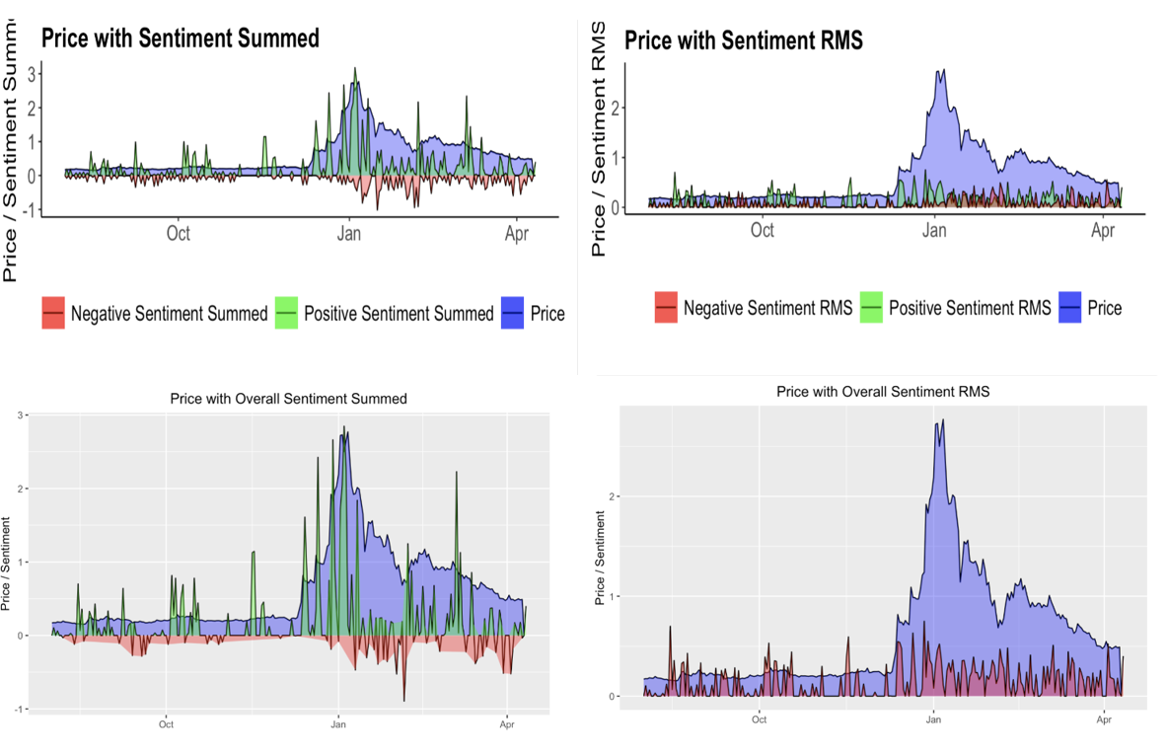
Sentiment Summed is a better indicator of XRP price changes than Sentiment RMS, as it shows a correlation with XRP price spikes, while Sentiment RMS does not.

Slide 28
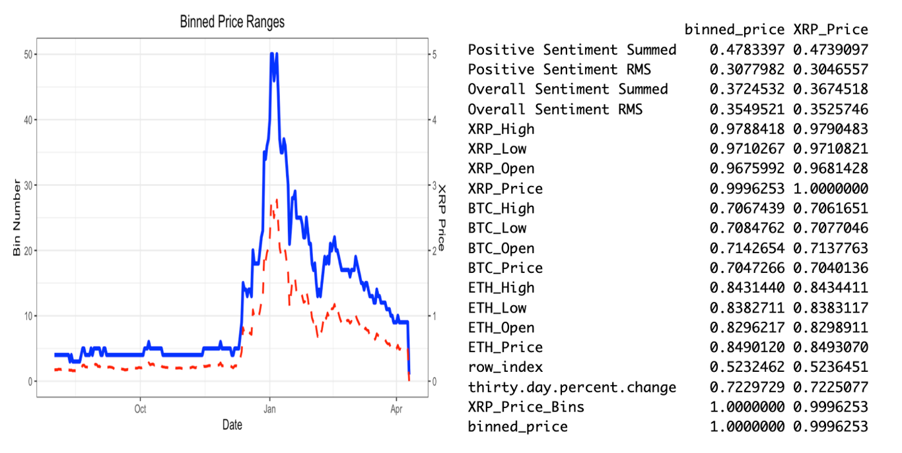
Price Range or Exact Price
correlation matrix
Correlating exact prices may
have been too precise, so as an
alternative method, XRP price
was divided into 50 different
ranges
Inferences:
Using price ranges (binning) for predicting XRP price did not significantly improve correlation coefficients but maintained them, making it a more practical approach for enhancing prediction accuracy.

Slide 29
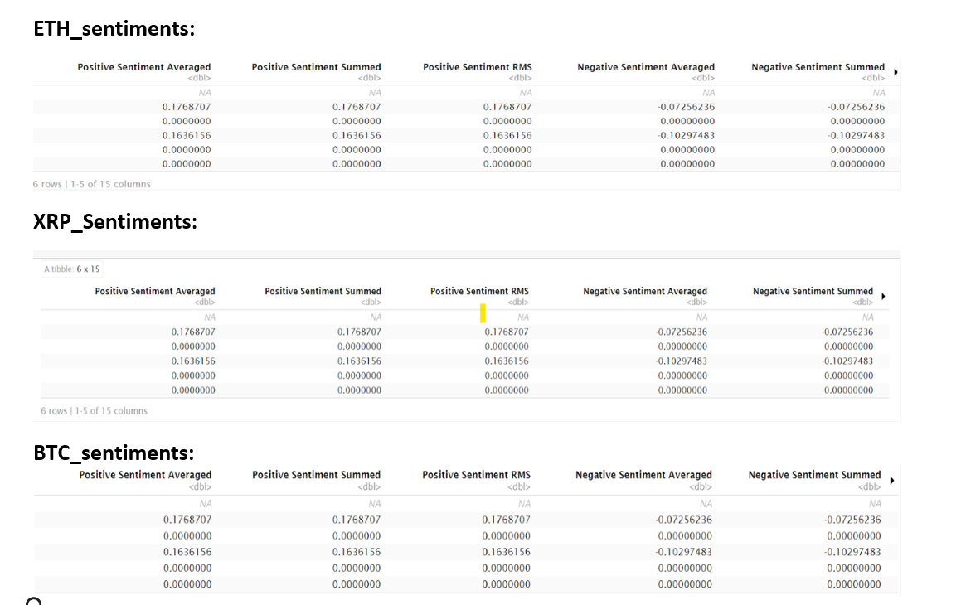
Model Training & Evaluation
To select which model performs the best for predicting the ETH Change, BTC Change and XRP Change variable from the sentiment predictors we implemented the following models.
Random forest
Lasso Regression
Multiple linear regression

Slide 30
Model Training & Evaluation
Steps we Performed:
Feature engineering: In each code, we prepared the data for training by selecting the predictor variables and target variable and splitting the data into training and testing sets using rsample. The training data is then used to build a random forest, Lasso, and Linear regression model using the appropriate package.
Evaluation metrics: We evaluated model performance on the testing data using three evaluation metrics: mean absolute error (MAE), root mean squared error (RMSE), and R-squared (R2). These metrics are commonly used to assess the accuracy and precision of regression models.
Model selection: Based on the metrics computed, we made the comparisons between the models and determine which model was suitable.

Slide 31
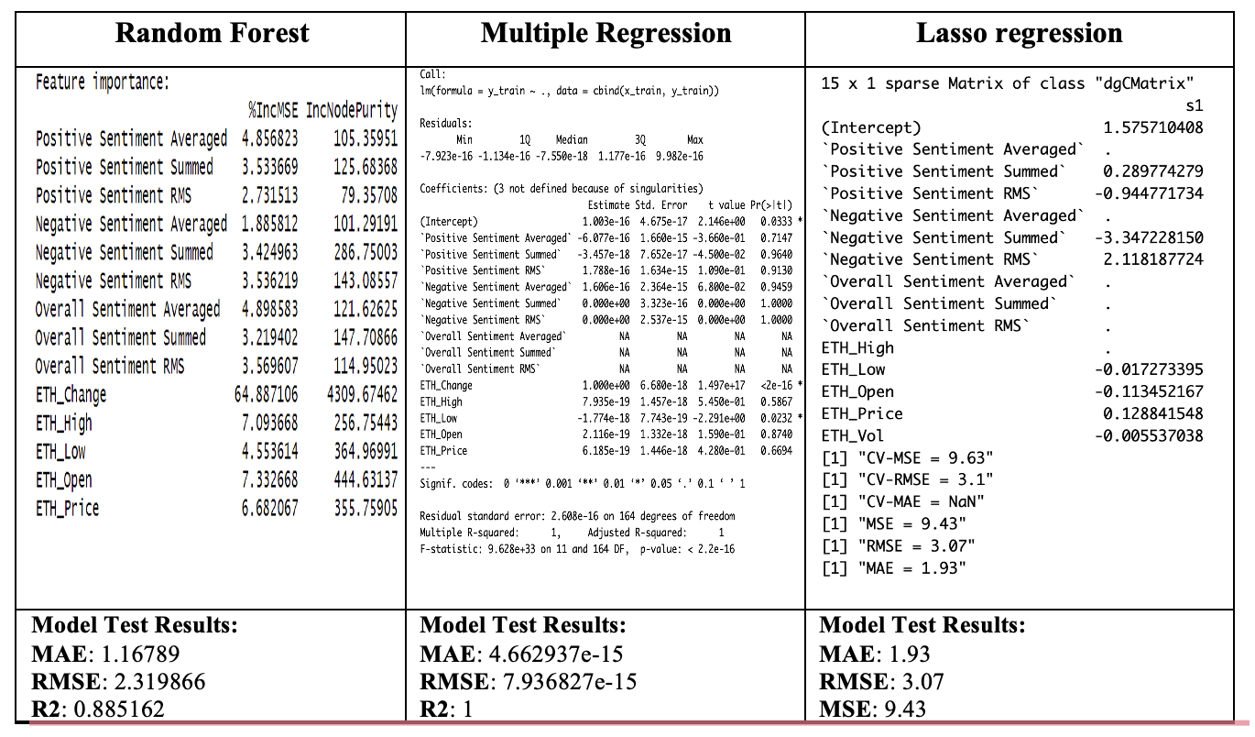
Model Comparison & Validation for ETH
Overall, it seems that the random forest model performs the best for predicting the ETH_Change variable.

Slide 32
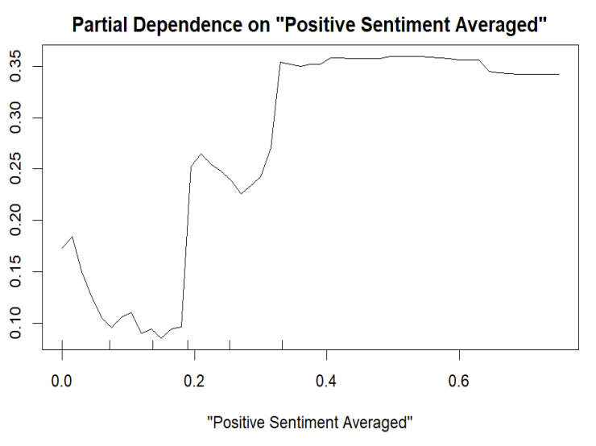
Plot for Random Forest

Slide 33
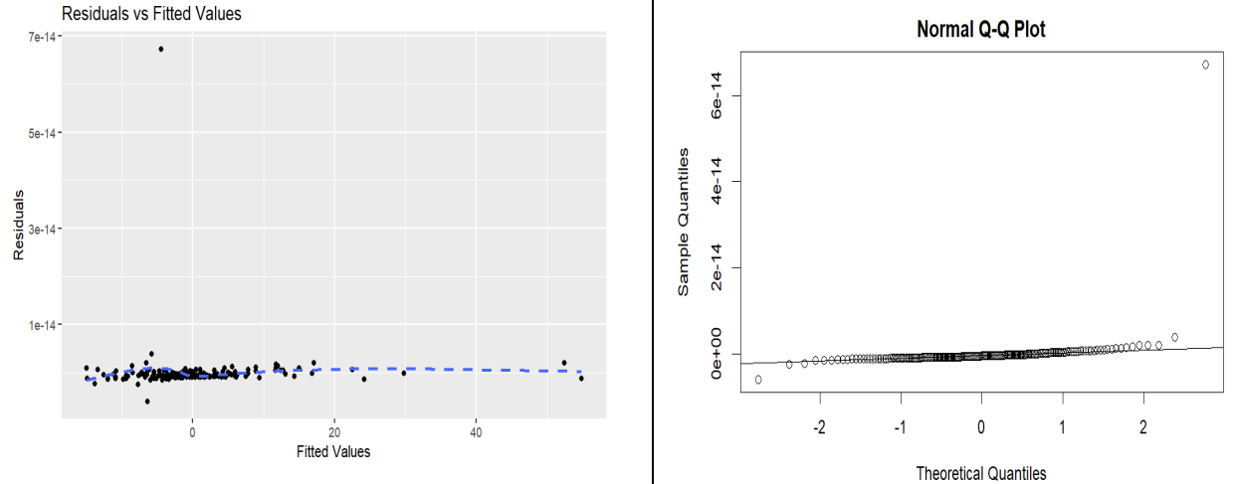
Plot for Multiple Linear Regression

Slide 34
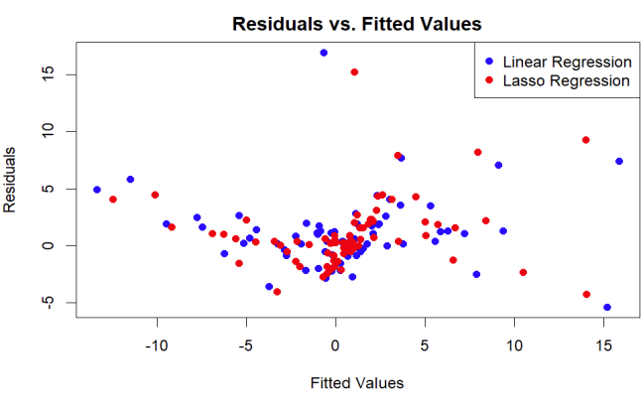
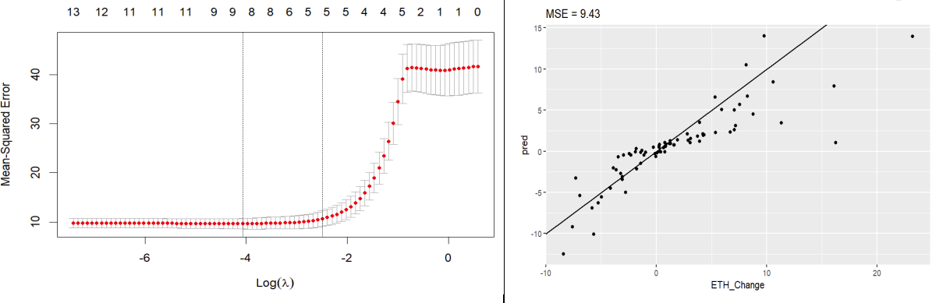
Plot for Lasso Regression

Slide 35
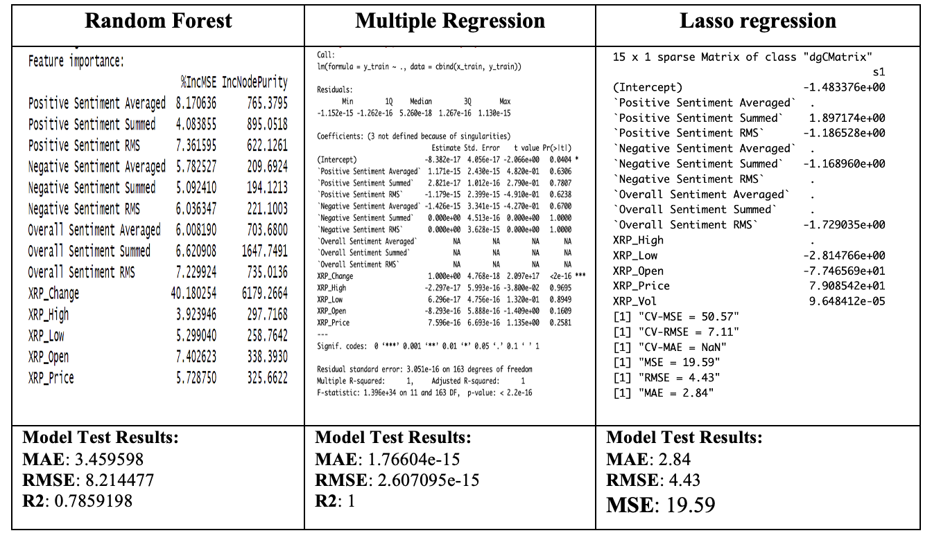
Model Comparison & Validation for XRP
Overall, it seems that the Lasso regression model performs the best for predicting the XRP_Change variable.

Slide 36
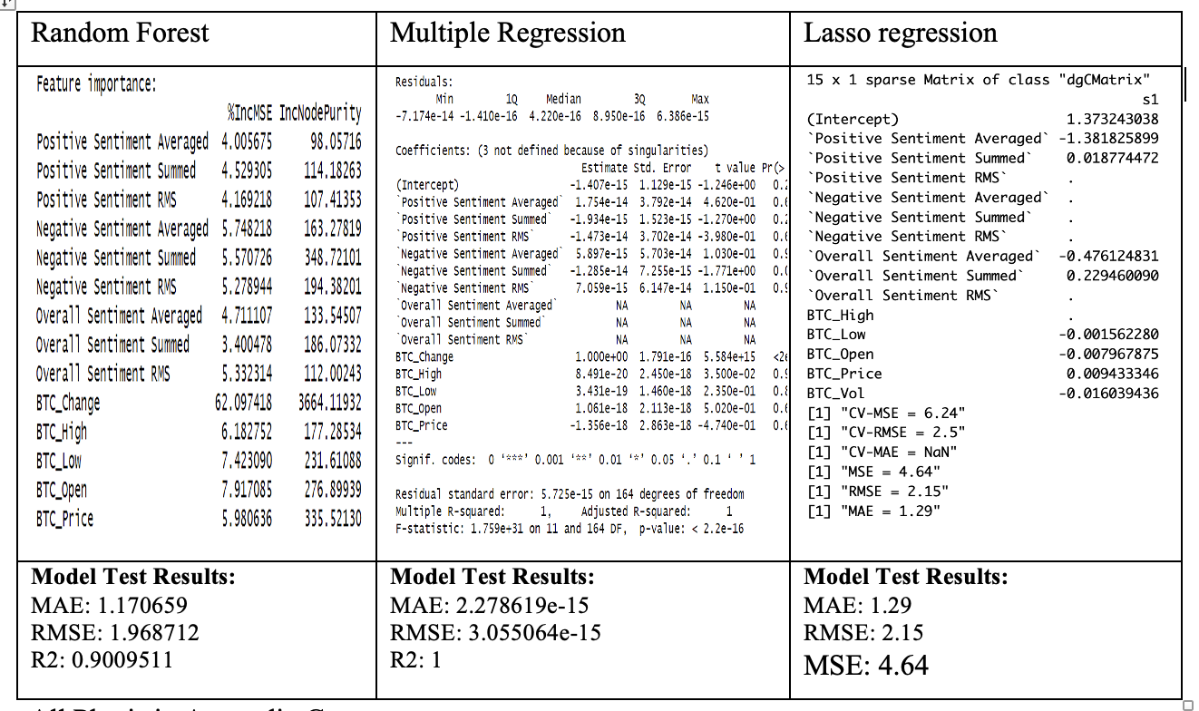
Model Comparison & Validation for BTC
Overall, it seems that the random forest model performs the best for predicting the BTC_Change variable, similar to the ETH_Change prediction.

Slide 37
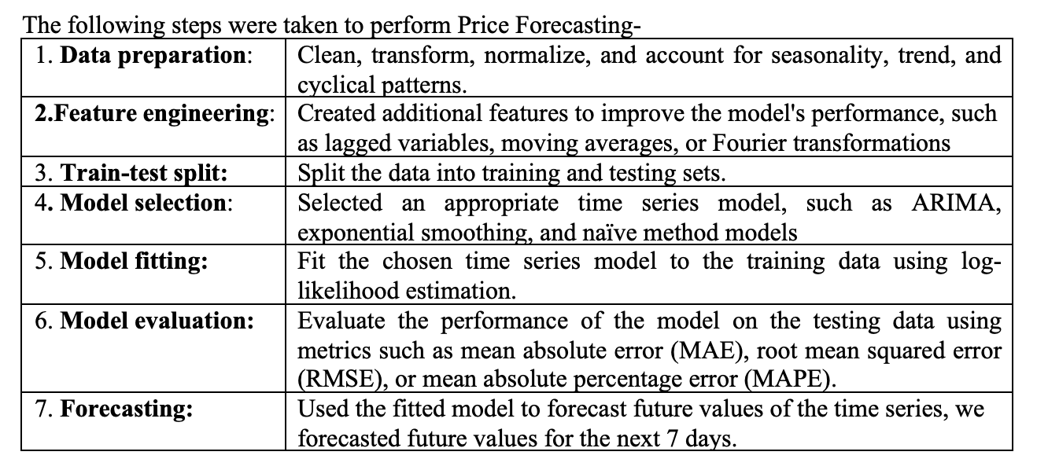
Price Forecasting

Slide 38
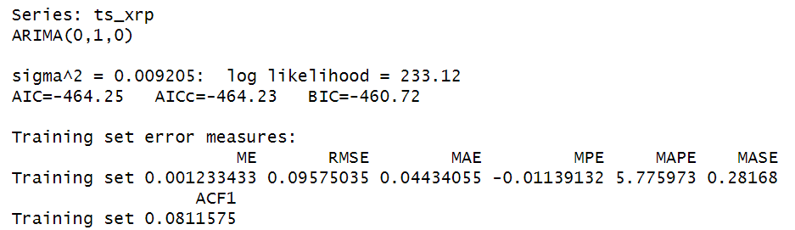
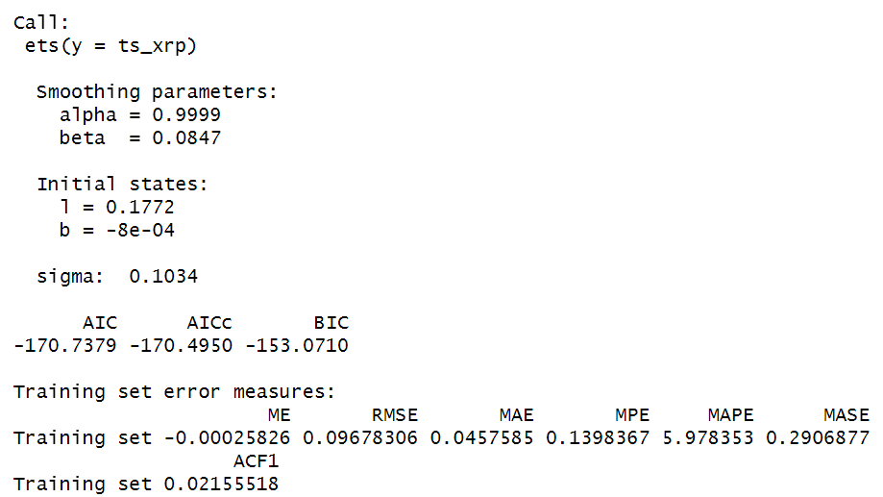
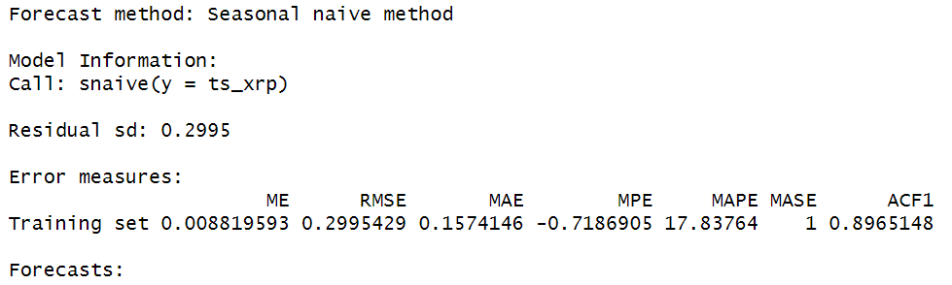
Price Forecasting
1. Time Series Model Selection
ARIMA Model
Exponential smoothing model
Naive model

Slide 39
Price Forecasting
To determine which forecasting method is better among ARIMA, seasonal naive method, and exponential smoothing model, we can compare their error measures and AIC/BIC values.
For ARIMA:
AIC=-464.25, AICc=-464.23, BIC=-460.72
Training set RMSE = 0.09575035
For Exponential Smoothing:
AIC=-170.7379, AICc=-170.4950, BIC=-153.0710
Training set RMSE = 0.09678306
For Seasonal Naive Method:
Training set RMSE = 0.2995429
Conclusions:-
Based on the AIC/BIC values, the Exponential Smoothing model has the lowest AIC/BIC value, indicating that it best balances goodness-of-fit and model complexity.
Based on the RMSE values, the ARIMA model has the lowest training set RMSE, indicating that it best fits the training data.

Slide 40
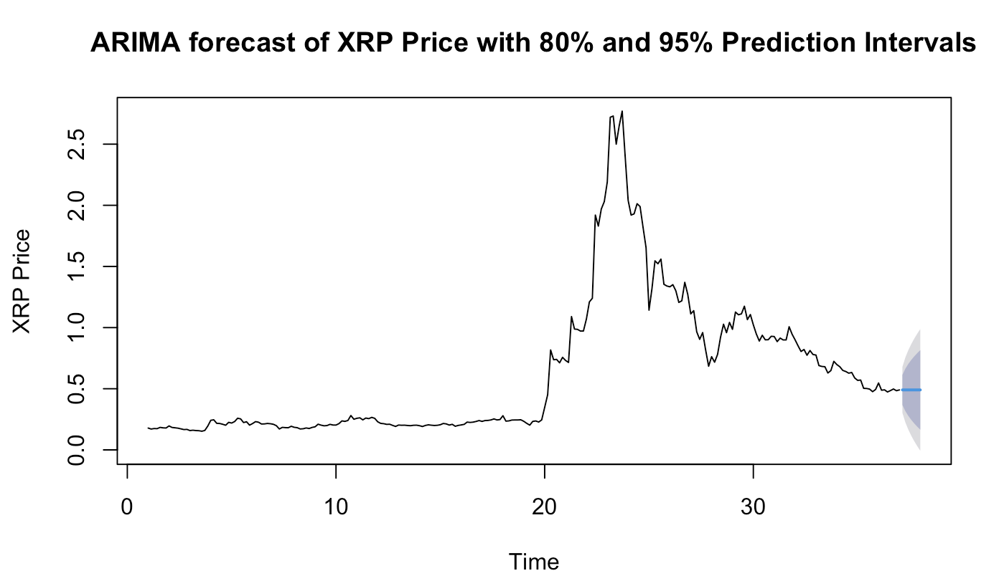
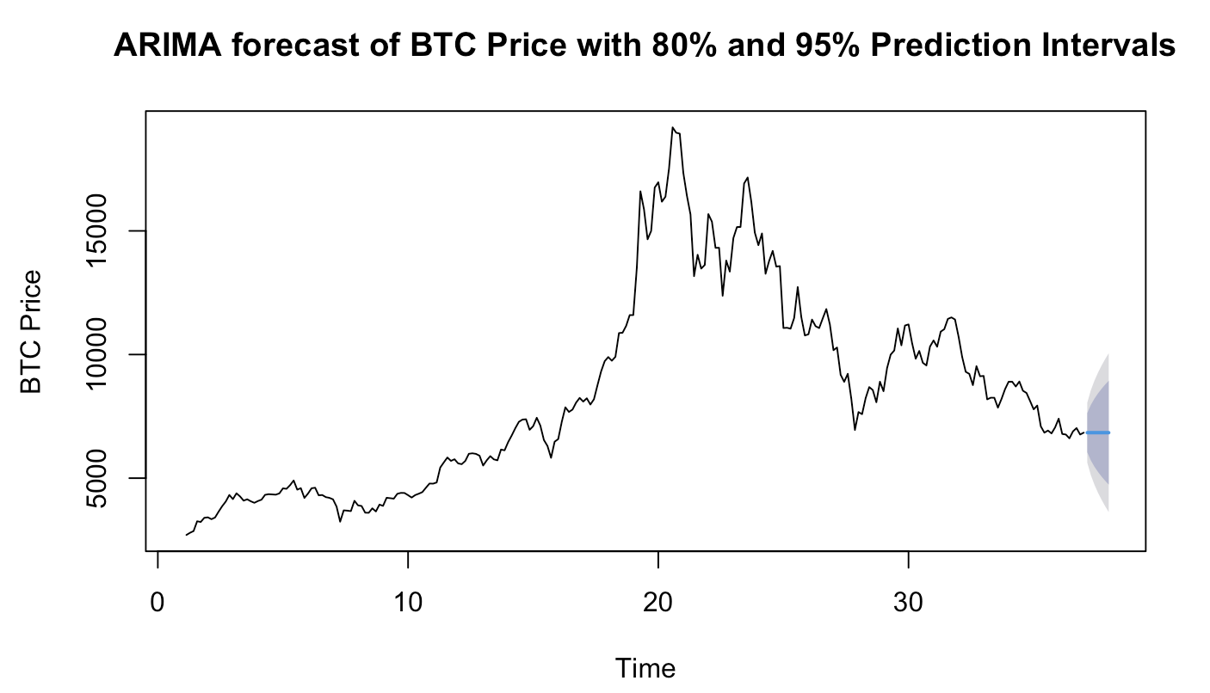
Price Forecasting
2. Next 7-Day Price (ARIMA model)

Slide 41
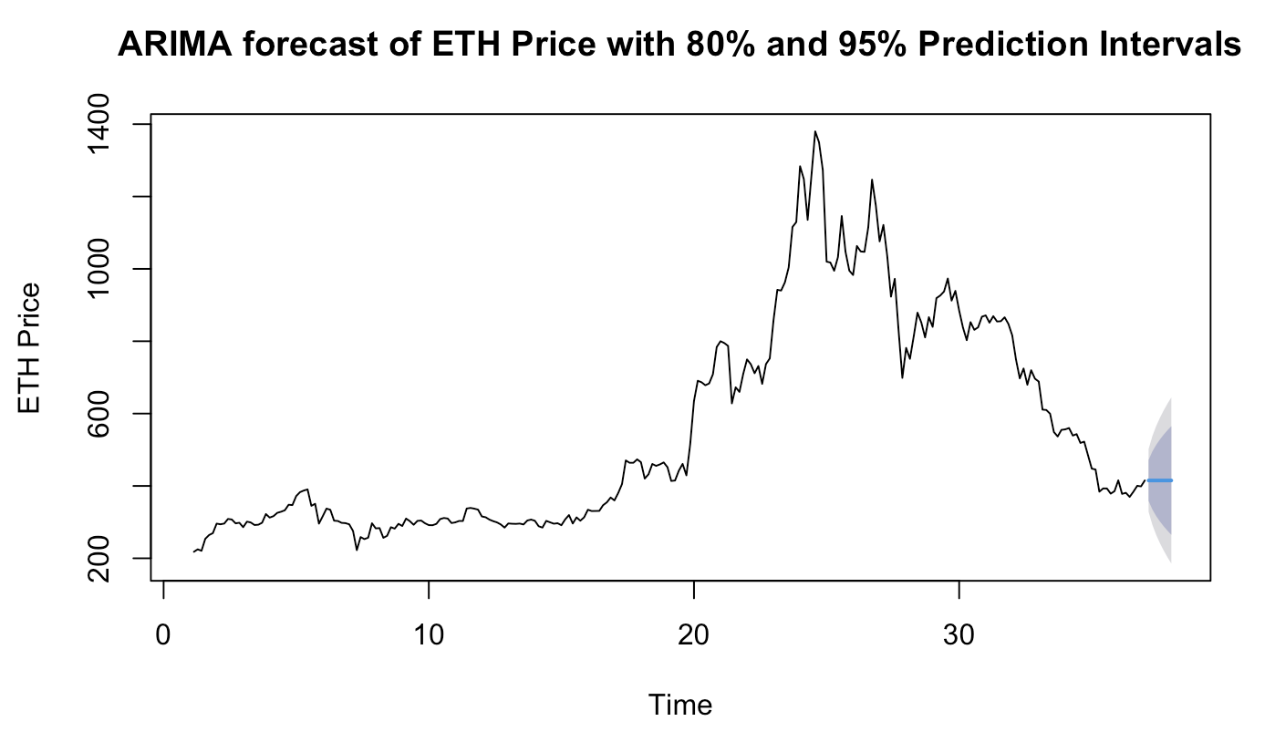
Price Forecasting
2. Next 7-Day Price (ARIMA model)

Slide 42

Price Forecasting
2. Next 7-Day Price (Ets model)

Slide 43

Price Forecasting
2. Next 7-Day Price (Ets model)

Slide 44


DNN Model Implementation
For fun we also attempted to implement a deep neural network model. Where we achieved 70% accuracy,
but tuning all the parameters could improve accuracy and this extend is out of the scope of this project.

Slide 45
Conclusion
This project involved multiple steps, including data exploration, correlation analysis, feature engineering, and model implementation.
Random forest and multiple regression models performed well for ETH and BTC price prediction, while multiple regression and Lasso regression performed well for XRP.
Sentiment analysis can be valuable in predicting cryptocurrency prices, but further research is needed to improve model accuracy and reliability.

Slide 46
Future Scope
For future work, we can explore more recent libraries such as XGBoost regression and NN (Neural Network) models in order to improve the predictions.
Other than the recent models, we can also explore various machine learning algorithms such as SVM and Decision Trees in hopes of improving the results.

Slide 47

Thank You!
Thank You!

